Slide 1

Software Engineering COMP 4110 University of Massachusetts Lowell Fall 2024
Team members:
Project Manager: James Walsh
Facilitator: Isaiah Andrade
Customer Liaison: Salwan Sabil
Configuration Manager: Gavin Ippolito
Instructor: Dr. James Daly

Slide 2
Project Overview
FlashCars transforms traditional flash card studying methods into an engaging educational trivia game.
Players answer questions correctly to advance in a competitive car race.
Traditional studying methods can feel uninspiring for students.
FlashCars addresses this by:
Making learning more interactive.
Help students retain knowledge better by combining learning with play.
Encourage study habits through a creative racing mechanic.

Slide 3

Overview of Features
Users get started by selecting a difficulty level (easy or hard) and a subject (math, science, or history) through on-screen buttons. After making their choices, they can click a button to display the game screen.
Upon starting the game, a question is displayed at the top of the screen with answer options below and the player's car on the track above the questions.
Correct answers move the car forward, while incorrect answers leave it in place.
The user is competing against a CPU opponent that is also moving towards the finish line.
The game ends once either vehicle reaches the finish line.
Users can also create an account by providing a username and password. The username will be displayed on screen once logged in.

Slide 4
Future Work
Some improvements for the future include:
Hide password while typing
Require strong passwords and unique usernames
Audio feedback
Screen to view statistics/account
Option to delete/modify account
Option for user to input their own questions
More premade question sets
Option to type in answers
Option to select vehicle
Changes in speed based on correct/incorrect answers
Hints for questions answered incorrectly
UI modifications

Slide 5
Domain Research
To ensure FlashCars aligns with key educational standards for 4th and 5th graders, resources such as the Massachusetts Department of Education and Common Core State Standards were utilized.
Extensive research of educational content was applied to integrate math, history, and science topics and questions to accurately reflect the 4th and 5th-grade curriculum standards.
Project Constraints:
Constraint 1: Target system must be a laptop or desktop with a keyboard and mouse.
Constraint 2: Hardware requirements include 16 GB of RAM, 100 GB SSD, and a GPU with 1 GB memory.
Constraint 3: The game requires the latest version of Unity and an internet connection for initial setup.
Notes:
This research was used to integrate math, history, and science topics and questions to accurately reflect

Slide 6
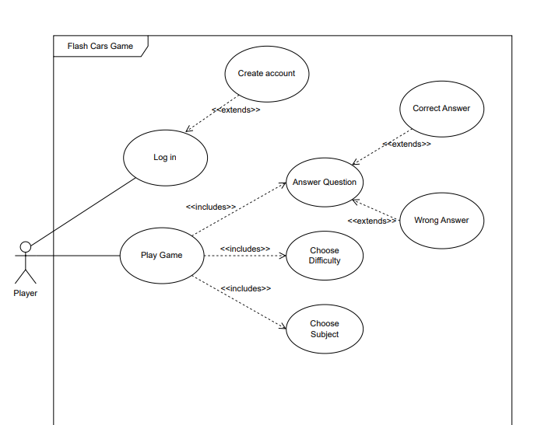
Use-Case Diagram

Slide 7
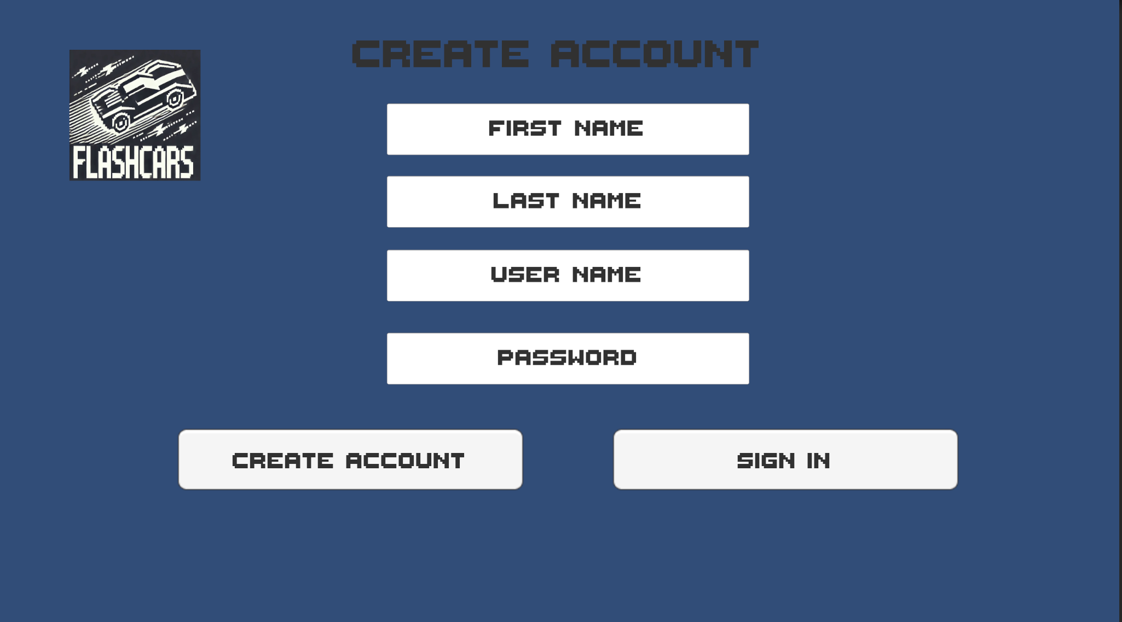
Demonstration: Creating an Account

Slide 8
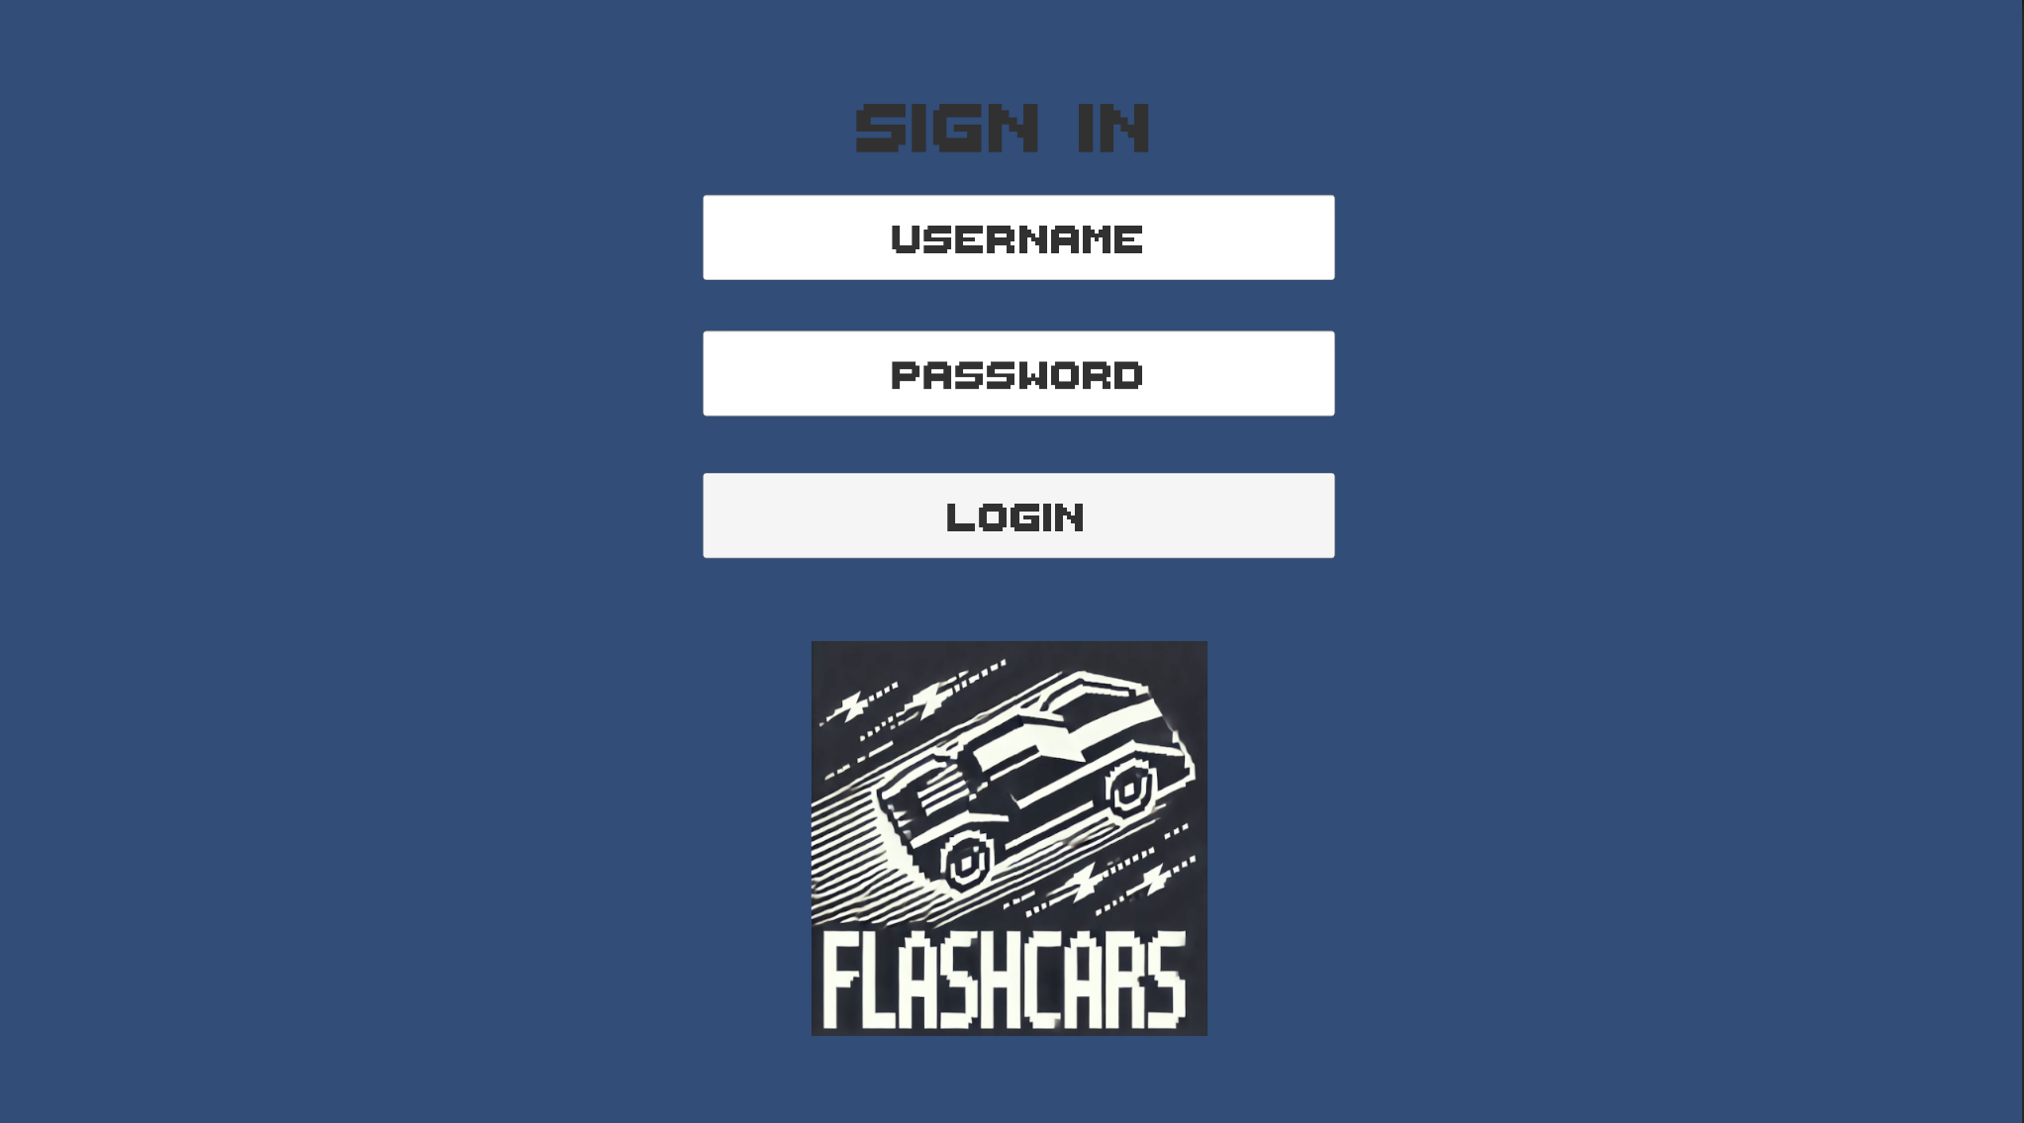
Demonstration: Sign in

Slide 9
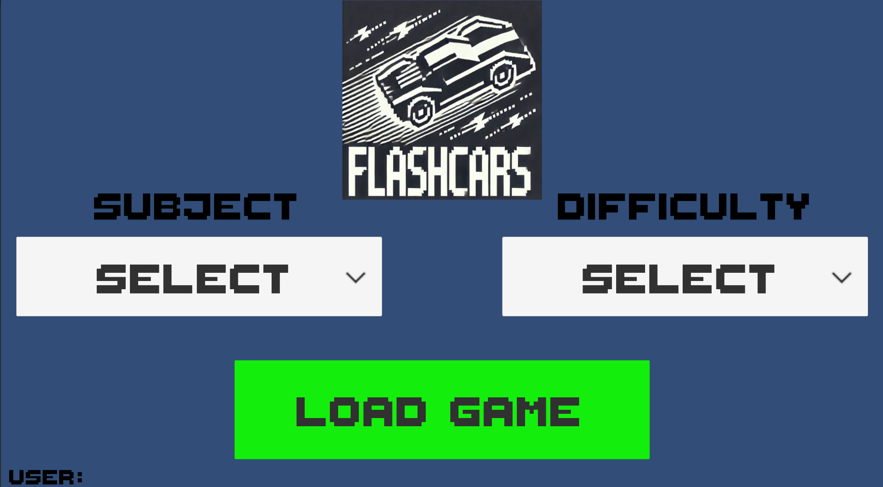
Demonstration: Main Menu

Slide 10
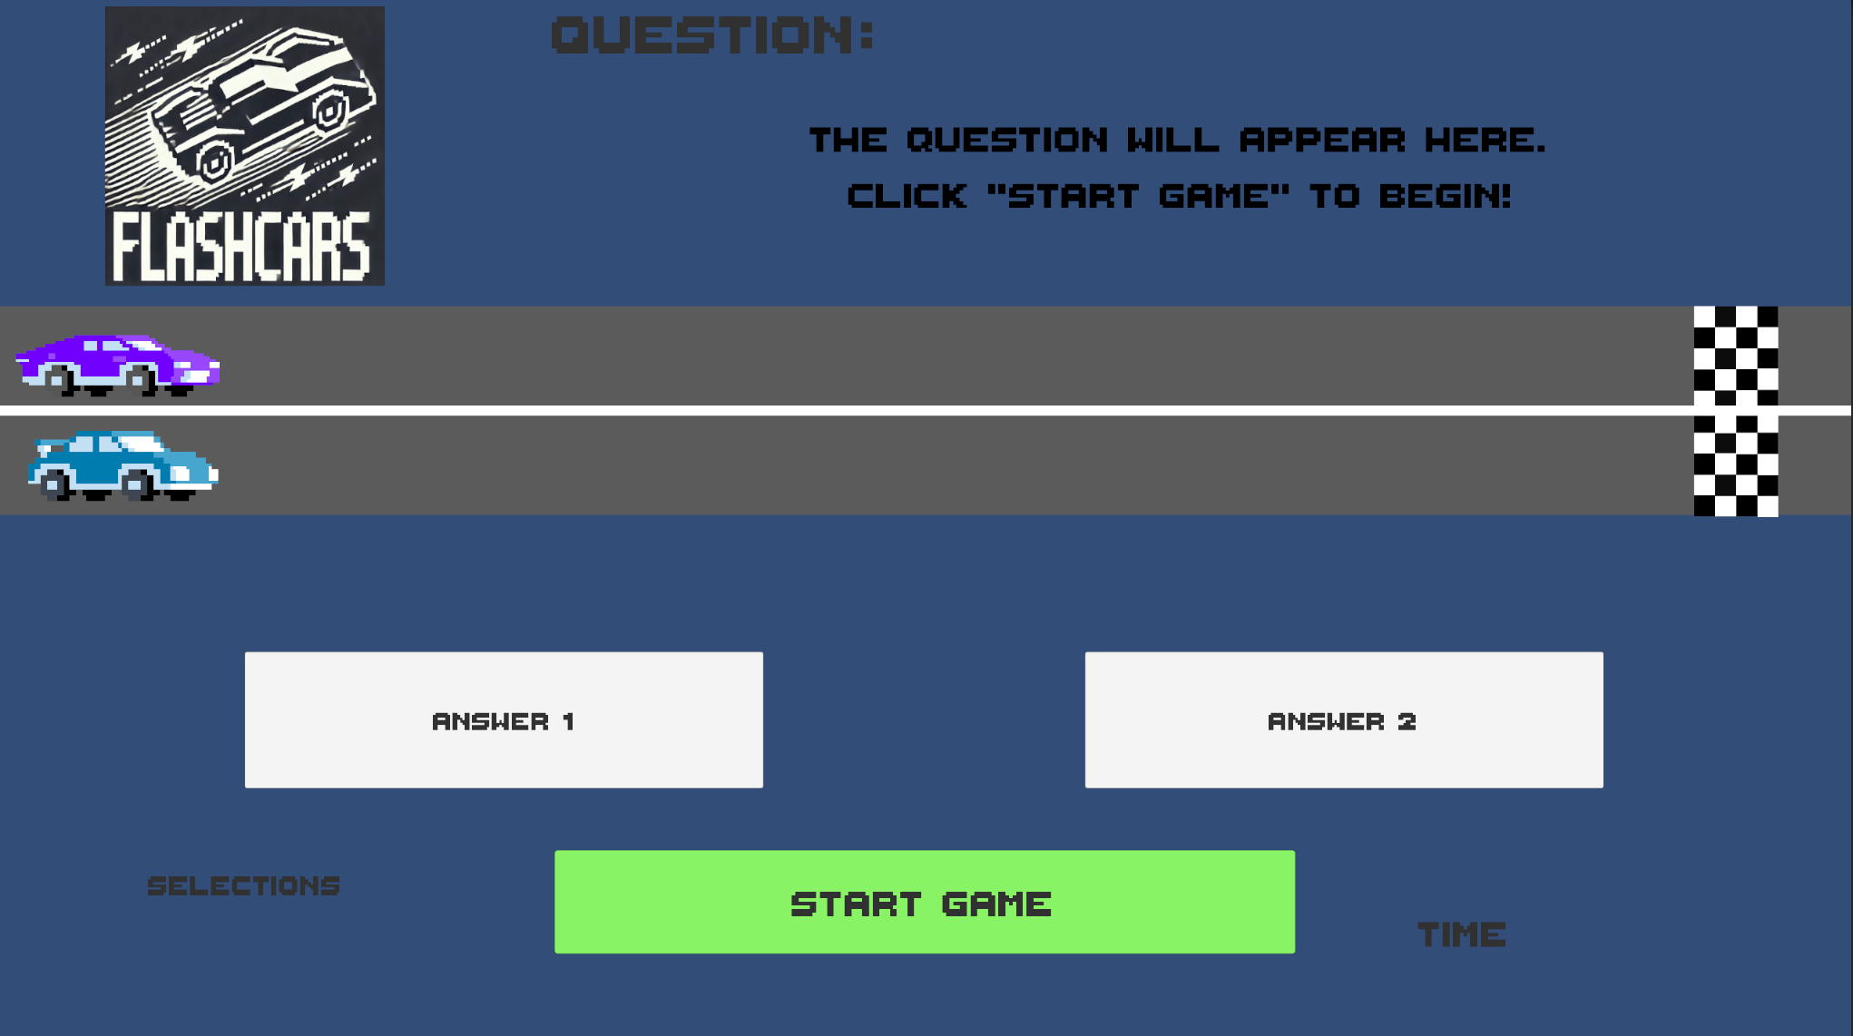
Demonstration: Game Play

Slide 11
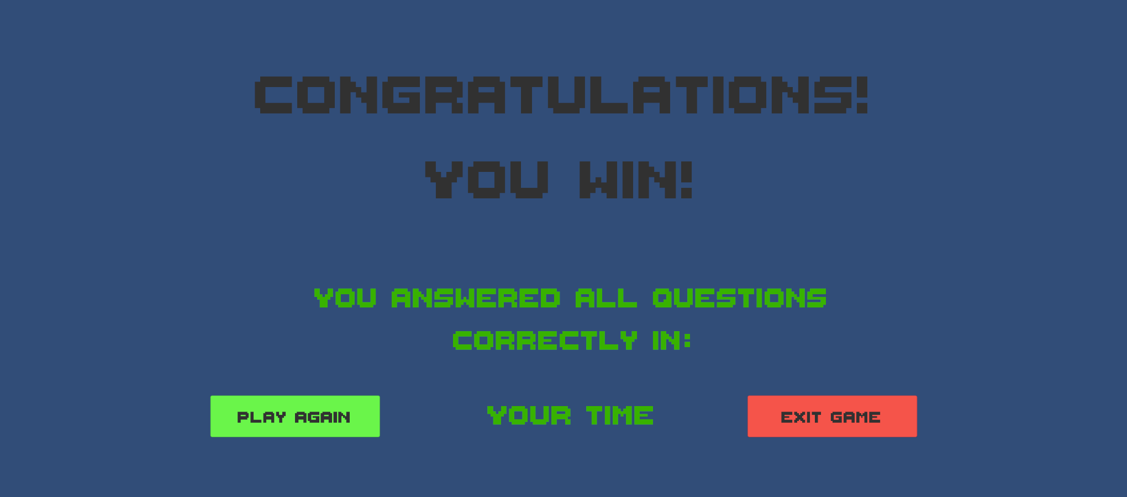
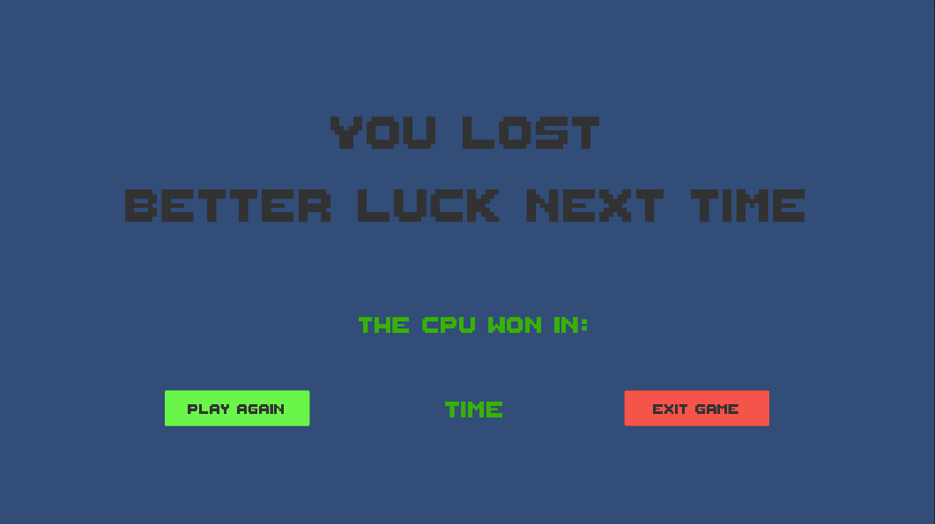
Demonstration: End of Game

Slide 12
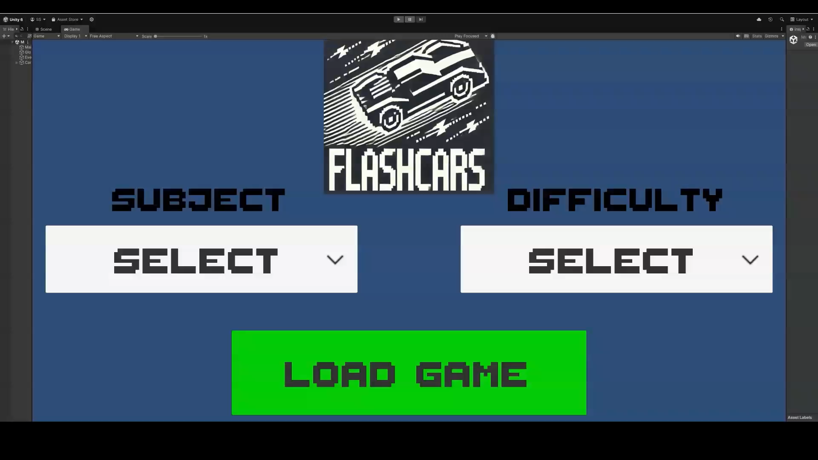
Demonstration: Video

Slide 13
Acknowledgements
We gratefully acknowledge and appreciate the participation of our customer, Dr. Daly from the University of Massachusetts Lowell.

